Slide 1
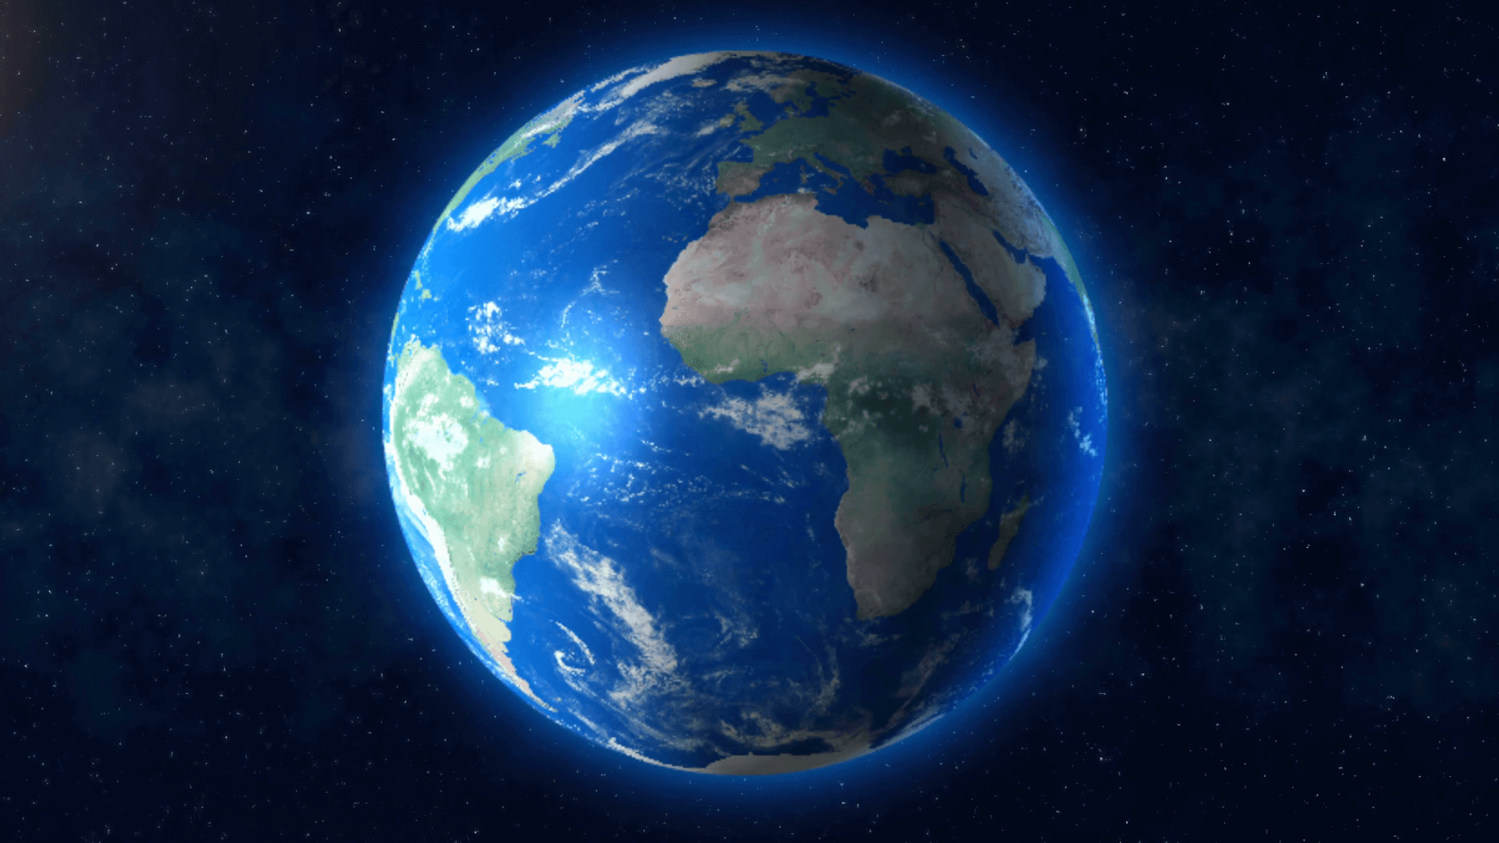
A World Of Water

Slide 2
Attendance

Slide 3
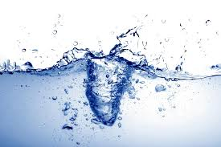
What do you hear?
https://www.youtube.com/watch?v=mg4kDY_hy6o

Slide 4
Power of Water
One of the main themes that is stressed in this chapter is based on the sheer power of water.
https://www.youtube.com/watch?v=4QW6Ebl5z4w

Slide 5
Essential Water Use VS. Non-Essential Water Use
Each group will be given a worksheet with the following question: “Essential Water Use VS. Non-Essential Water Use”
In your groups come up with 5-6 answers for each questions (10-12 total)
Afterwards each group will share their top three answers with the class.

Slide 6
Key Terms
Impermeable
Porous
Run-off
Upstream/ Downstream
Valley
Lake
Ocean
River

Slide 7
Impermeable
A smooth, hard surface in which water can not pass through.

Slide 8
“Earth has been called ‘the blue planet’. From space, its surface appears to be mostly oceans of liquid water. Water vapour is found in Earth’s atmosphere. Frozen water occurs on mountaintops and at the North and South poles. The bodies of animals and plants consist mainly of water. For example, sixty-five percent of your body mass is water. Water is not only plentiful, it is also always on the move. It moves in and out of our bodies. It flows from ice cubes melting in a drinking glass. It evaporates into the air from wet clothes and falls from clouds as rain or snow. The best way to understand Earth’s water supply is to study it as a system – a closed system in which water constantly moves around between sea, sky, land and life.” (pg. 310)

Slide 9
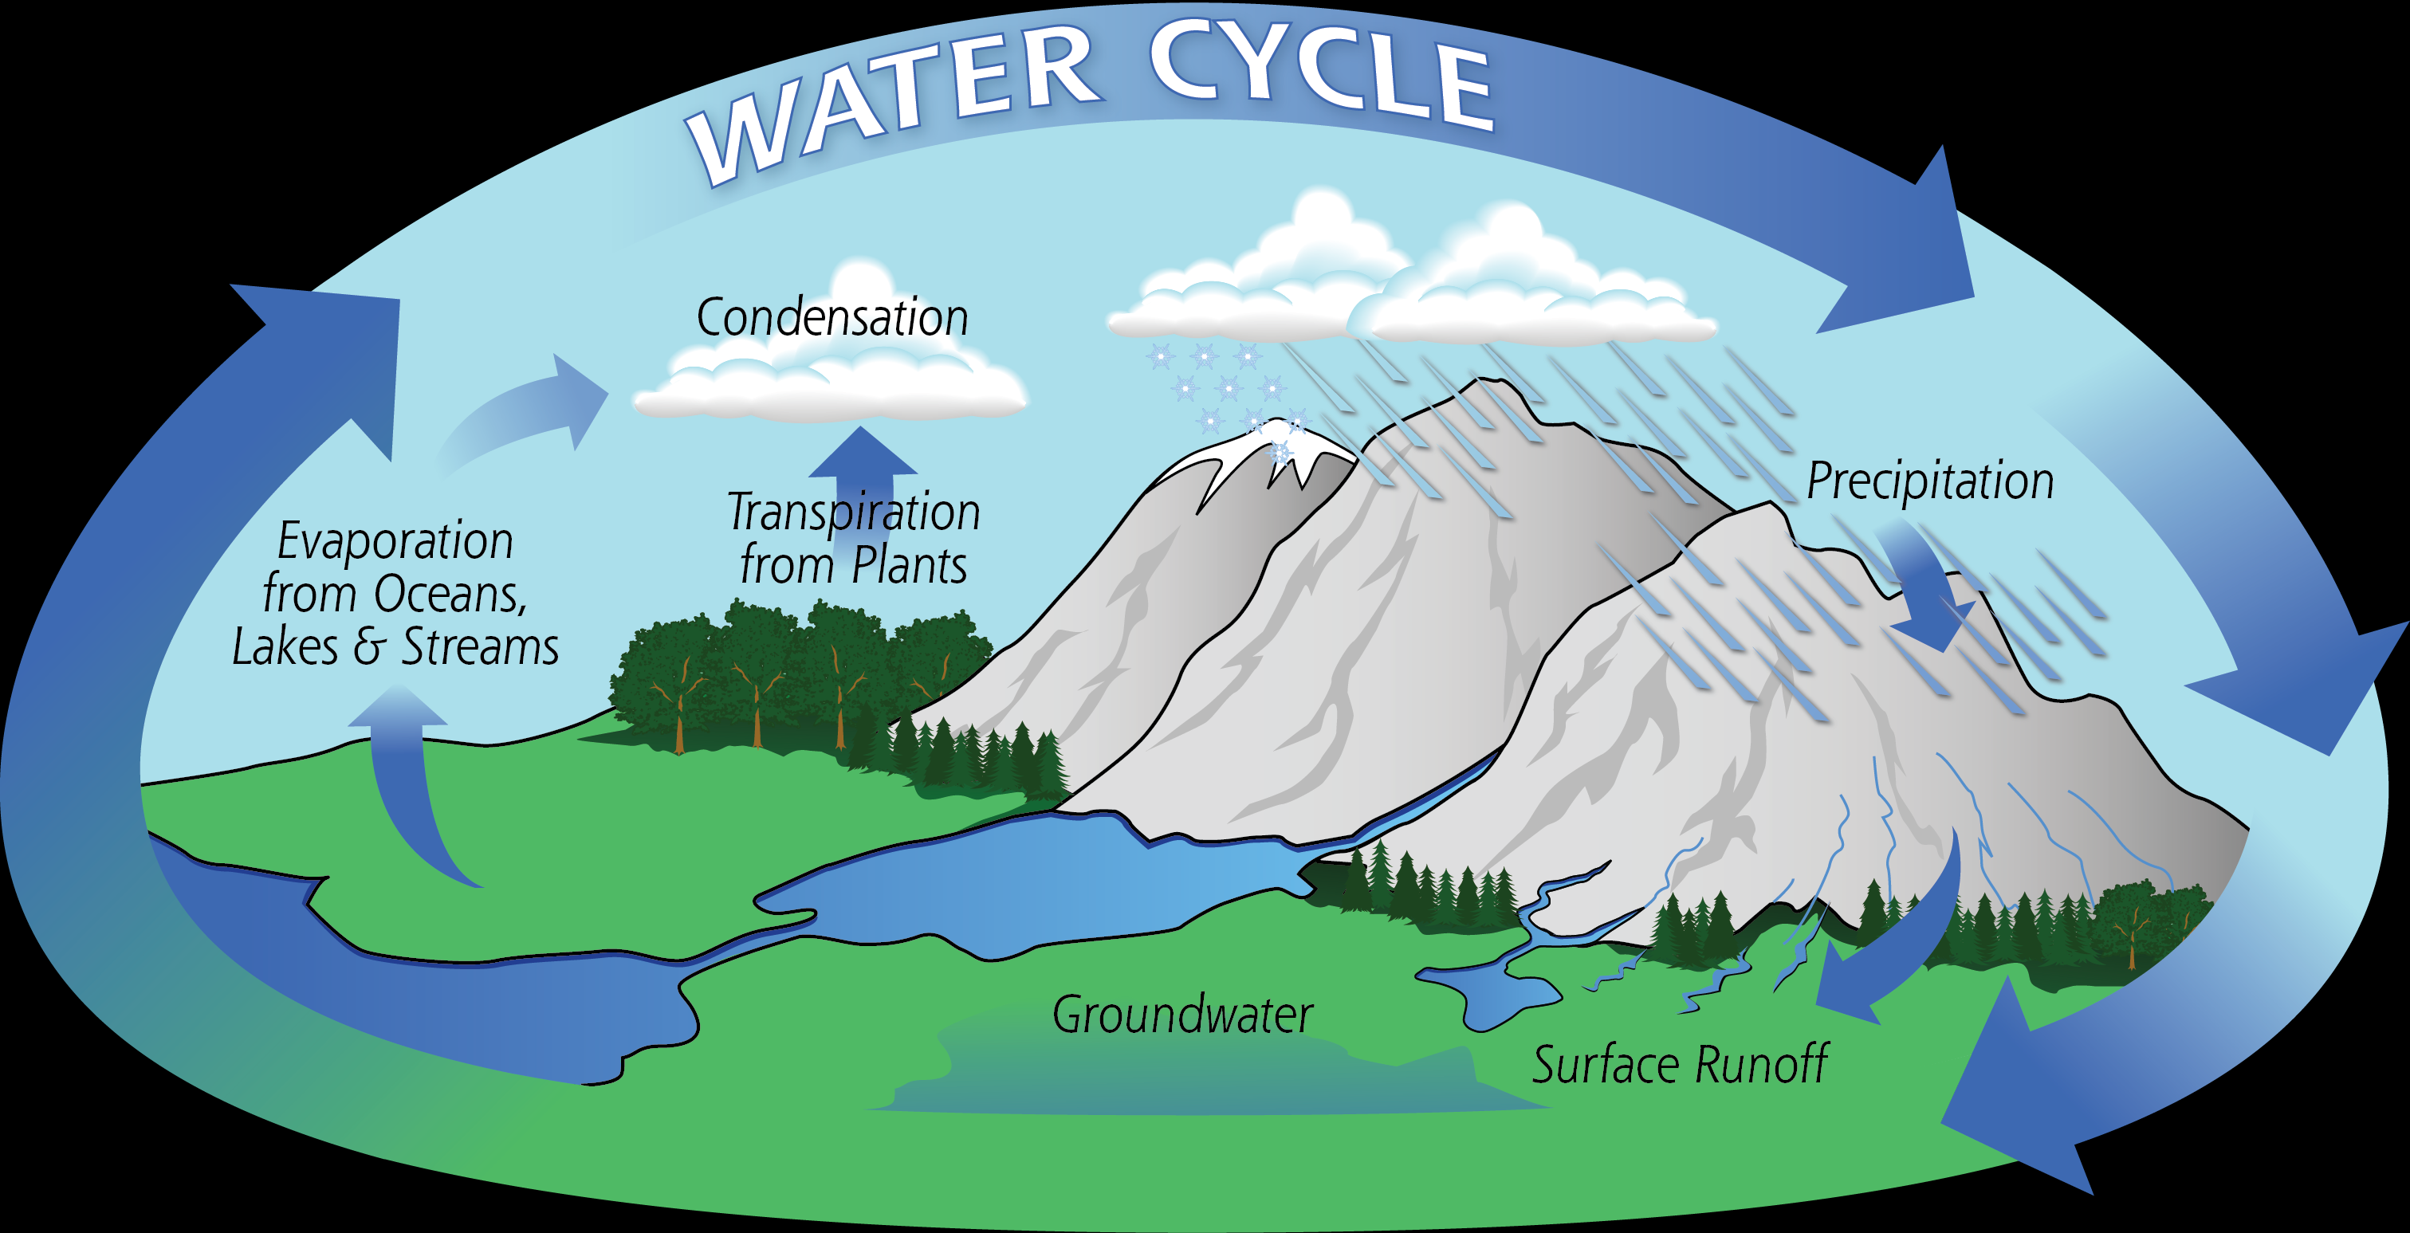

Slide 10
Where Will This Unit Take Us?
Flooding (Preventable??)
Rivers/Valleys/Oceans (How are they formed?)
Different forms of water
Maps of Water systems
The Water Cycle

